Slide 1

Housing Project
Prepared by:
Abhishek Harindran

Slide 2
INTRODUCTION
Business Problem
A US-based housing company named Surprise Housing has decided to enter the Australian market. The company uses data analytics to purchase houses at a price below their actual values and flip them at a higher price.
The company is looking at prospective properties to buy houses to enter the market. You are required to build a model using Machine Learning in order to predict the actual value of the prospective properties and decide whether to invest in them or not. For this company wants to know:
• Which variables are important to predict the price of variable?
• How do these variables describe the price of the house?

Slide 3
Analytical Problem Framing
Mathematical/ Analytical Modelling of the Problem
Describe the mathematical, statistical and analytics modelling done during this project along with the proper justification.
Data Sources and their formats
A US-based housing company named Surprise Housing has decided to enter the Australian market. The company uses data analytics to purchase houses at a price below their actual values and flip them at a higher price. For the same purpose, the company has collected a data set from the sale of houses in Australia. The data is provided in the CSV file below.
The company is looking at prospective properties to buy houses to enter the market. You are required to build a model using Machine Learning in order to predict the actual value of the prospective properties and decide whether to invest in them or not. For this company wants to know:
What are the data sources, their origins, their formats and other details that you find necessary? They can be described here. Provide a proper data description. You can also add a snapshot of the data.

Slide 4
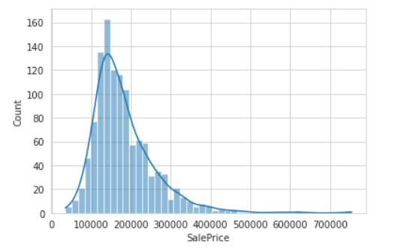
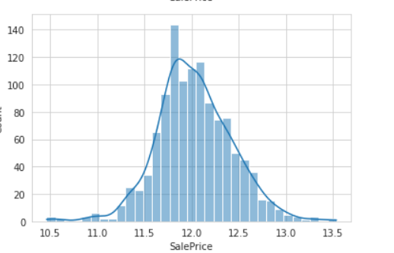
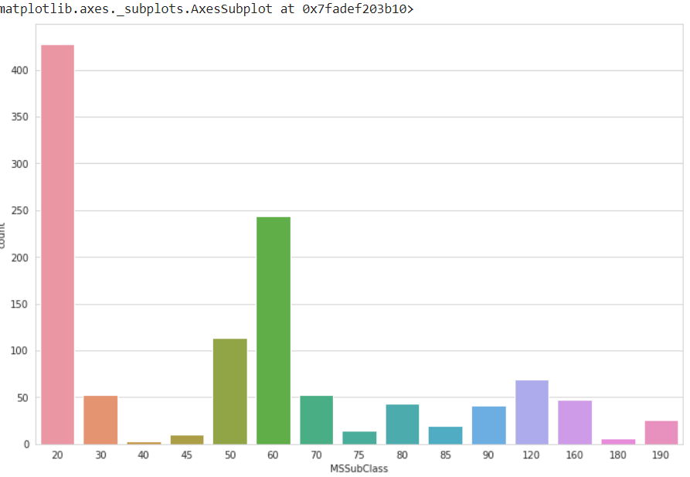
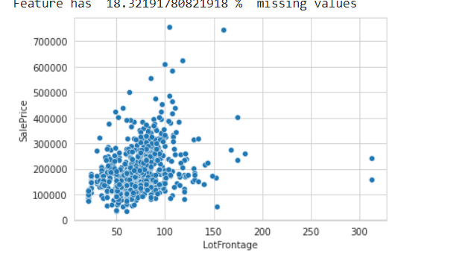
Data Preprocessing

Slide 5
Hardware and Software Requirements and Tools Used
Model Development and Evaluation
Problem solving methods
Approach followed during the course of predicting the house sales price Data given was imported as DataFrame. Next, the basic information like the datatypes, checking the count of non-null values in the data with info() function, then summary statistics of both numerical and categorical data which provides us the information about the count, frequency, unique, top values for the categorical data and mean, standard deviation, minimum, maximum, 25th percentile ,50th percentile, percentile (median), 75th percentile of the numerical data.
Checking null values, imputing the null values, dropping the
columns with null values almost close to the size to data, plots like countplot, barplot, regression plot, categorical plot were plotted to check the effectiveness of the input variable with the target variable and its behaviour.
Next, correlation matrix was plotted through which we could identify the how the input variable is correlated with the target variable and also, we see the multicollinearity which is even checked by seeing the variance inflation factor.
Next skewness was checked and removed with log and square transforming methods. Next outliers were identified.
Later the data was split into features (X) and target (y).
MinMaxScaler method was used for transforming and to reduce the dimensionality of the data PCA (principal component analysis) was used.
Model Building – 5 models used for training along with cross
validation and the best model was tuned with hyperparameters. And the two models were deployed one with tuned one and other without and comparison was done with predicted and original with plots.
Lastly, the price was predicted for the test data provided which was cleaned before predicting the sales price of the house

Slide 6
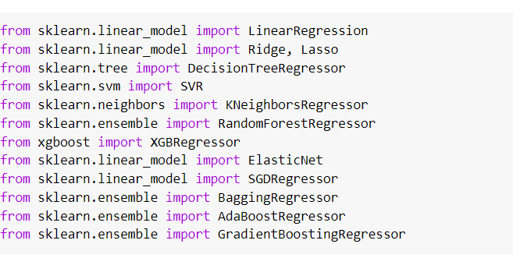
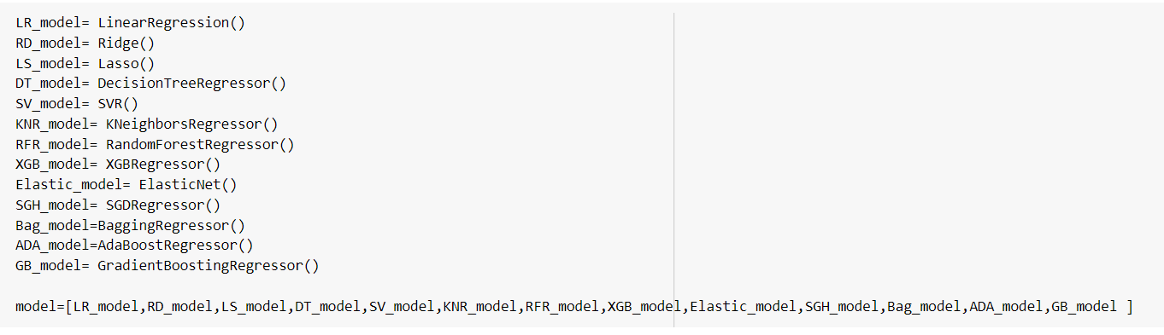
Algorithms used

Slide 7
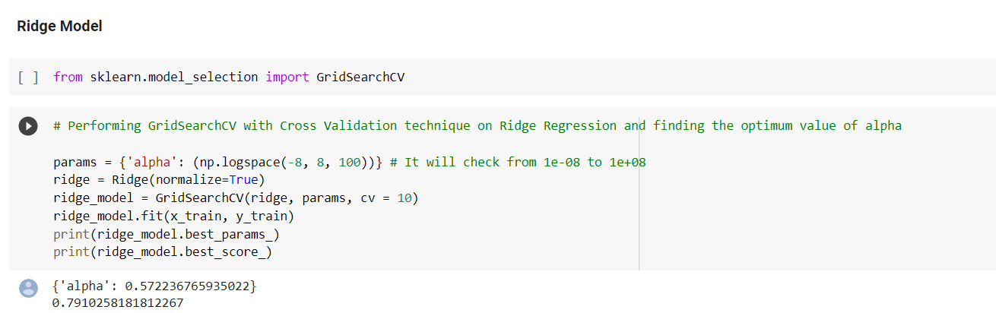
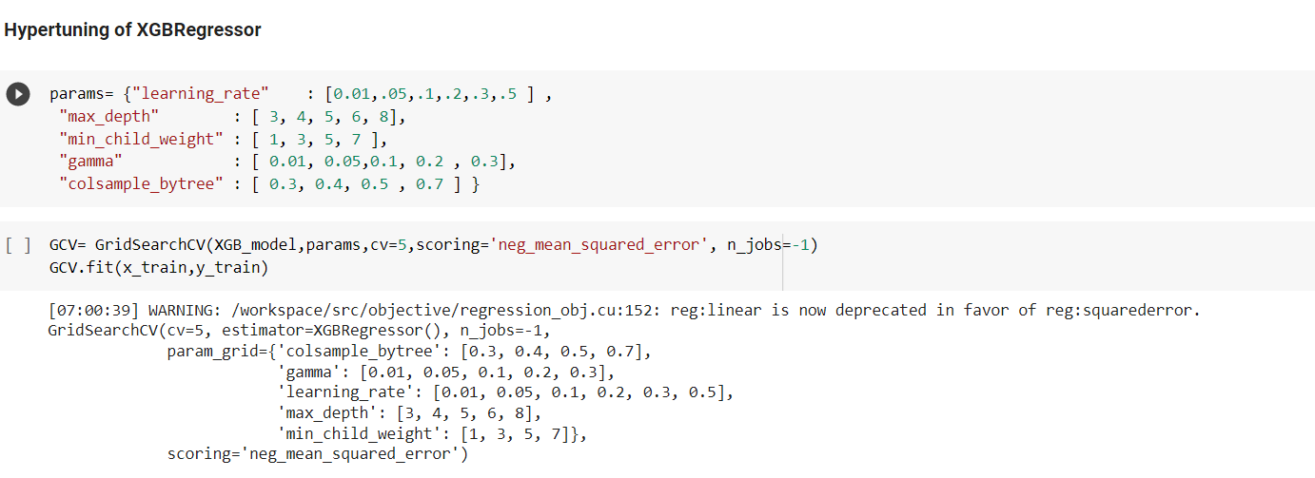

Slide 9
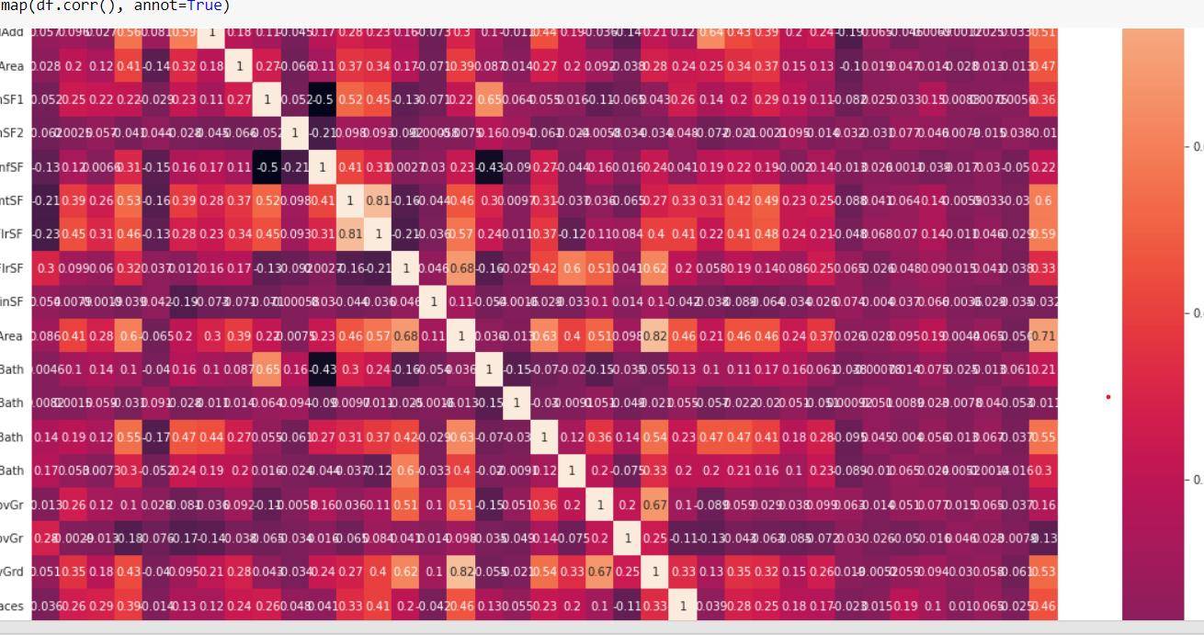
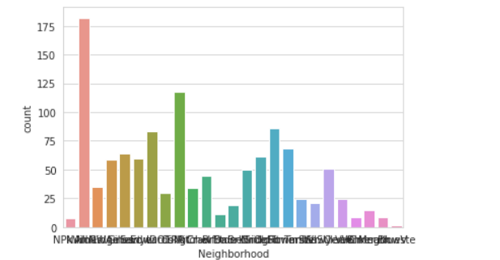
Visualizations

Slide 10
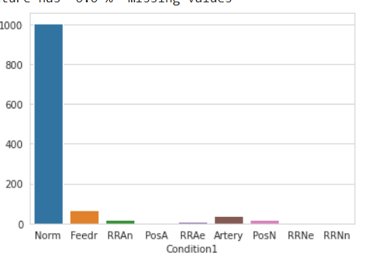
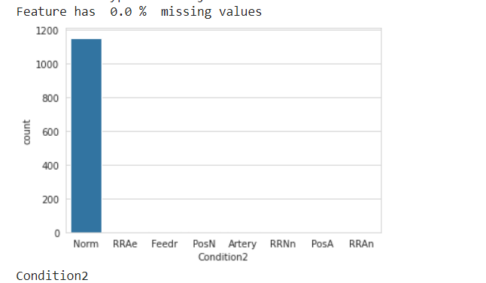
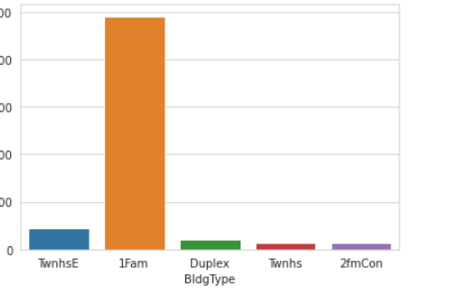
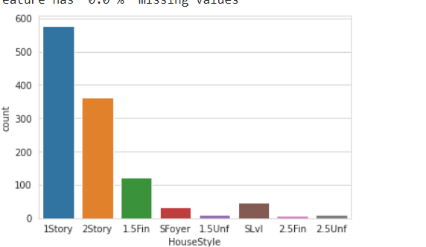

Slide 11
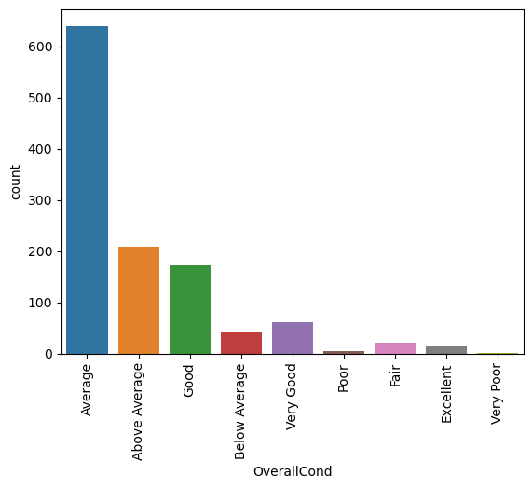
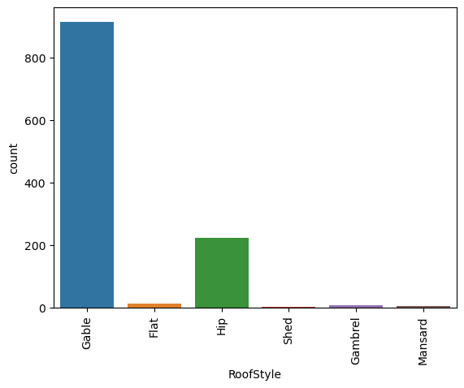
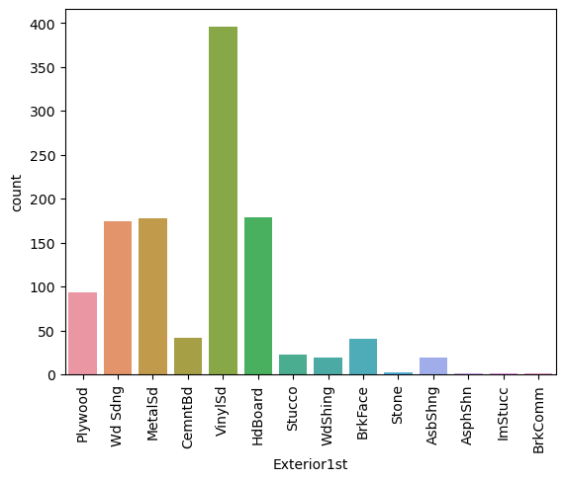
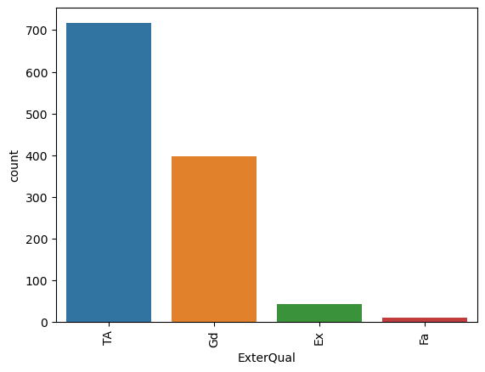
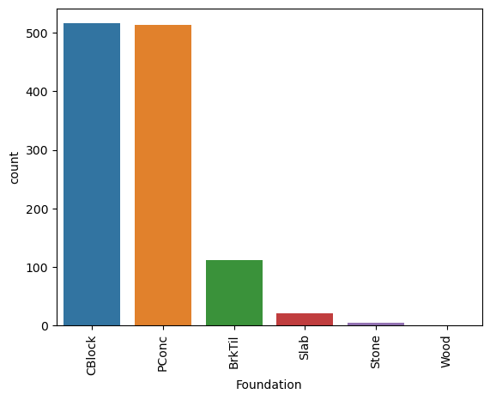
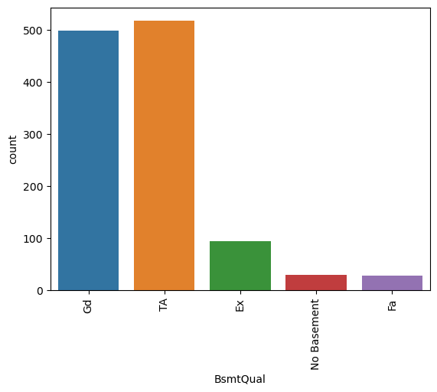
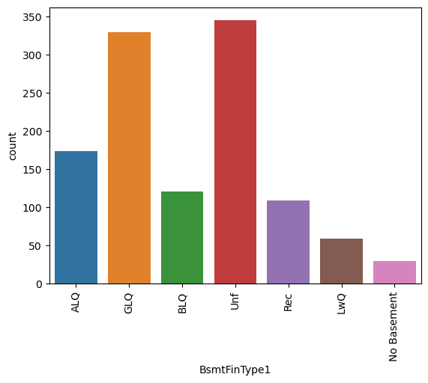
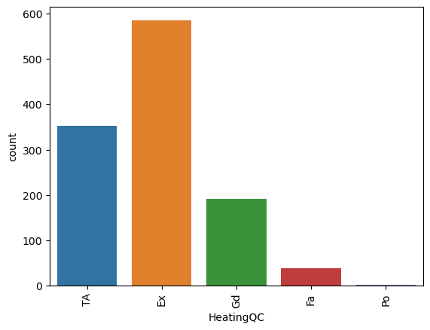

Slide 12
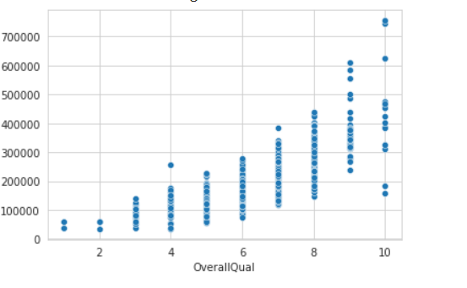
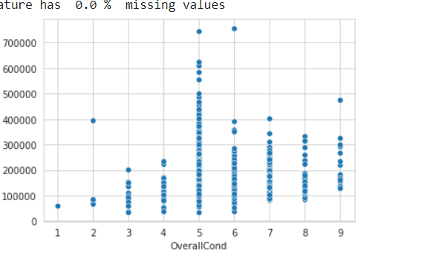

Slide 13
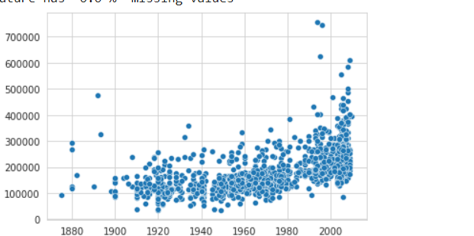

Slide 15
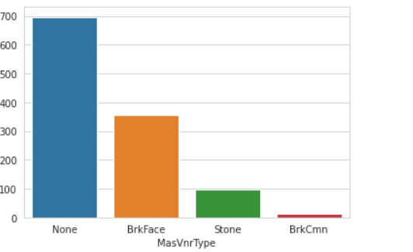

Slide 16
Learning Outcomes
What I learned here is how one has to extensively look at the data and see its behaviour with help of EDA. This will help us identify the important features for predicting the target.
Scope for Future Work
The data can be more explored for feature engineering with more literature review.
The Outliers present can be treated in a more efficient way to improve the accuracy of the model.
We can apply more algorithms along with hyper tunning parameters to improve the accuracy.

Slide 21
.

